Slide 1
Machine Learning and Neural Networks
Supervised By : Dr. Ali Alrodan
Number | Student ID | Student Name
1 | 0224969 | Noor Mahmoud Ali Almazaydeh
2 | 2220728 | Ola Ali Naim Alkurdi
3 | 2221775 | Sahar Abdulhay
4 | 0226202 | Ruaa Ali Naim Alkurdi

Slide 2
Introduction
Time series :
Predict Forecast benzene (C₆H₆) concentration in the air using time series data.
Techniques Used: Time Series Models(ESN, LSTM and Bi-LSTM).
Dataset Information:
Dataset: Air Quality UCI Dataset.
Source: UCI Machine Learning Repository.
Records: 9,357 hourly entries.
Features: 15 environmental and sensor-based variables.
Time Format: Date and Time merged into datetime index for time series modeling.
Importance:
Supports public health and environmental monitoring by predicting carcinogenic pollutant levels for early interventions and air quality management.
Classification:
Predict the traffic situation (Heavy, High, Normal, Low) using vehicle count data.
Techniques Used: Machine learning models (SVM, MLP, Random forest).
Dataset Information:
Two datasets: Traffic.csv and TrafficTwoMonth.csv ~9,000 total records after merging and 10 features(CarCount, BikeCount, Date, e.g.)
Importance:
Supports smart city initiatives and traffic optimization.

Slide 3
Pre-processing
Time series:
Data Cleaning: Removed empty, redundant, and invalid columns.
Timestamp Creation: Combined date and time into a unified datetime format.
Handling Missing Data: Dropped rows with missing values to ensure data quality.
Scaling: Normalized feature values to a standard range.
Exploratory Analysis: Visualized trends, correlations, and target distribution.
Sequence Preparation: Transformed time series data into input-output sequences.
Data Splitting: Split data into training, validation, and test sets.
classification:
Dataset Merging: Combined Traffic.csv and TrafficTwoMonth.csv into one dataset.
Outlier Removal: Used IQR method to clean vehicle count columns.
Feature Engineering: Extracted Hour, Day, Month from Time and DateCreated Weekend feature.
Normalization: Applied Quantile Transformer to scale vehicle.
counts.Encoding: Used OneHotEncoder for categorical features (Day of the week, Source)Used LabelEncoder for the target (Traffic Situation).
Data Splitting: Split the dataset into 80% training and 20% testing.

Slide 4

Methodology for Time Series
Echo state network(ESN)
Architecture: Reservoir layer with sparse connections to capture temporal dynamics.
Hyperparameters: Reservoir size 500, spectral radius 0.95, input scaling 0.5 , ridge alpha 1e-6 , Time steps 24
Long Short-Term Memory(LSTM):
Architecture: 2 LSTM layers
Training: Loss Function: Mean Squared Error (MSE), optimizer: Adam, Epochs: 50, Batch Size: 32)
Bidirectional Long Short-Term Memory(Bi-LSTM):
Architecture: 2 LSTM layers
Training: Loss Function: Mean Squared Error (MSE), optimizer: Adam, Epochs: 50, Batch Size: 32)

Slide 5
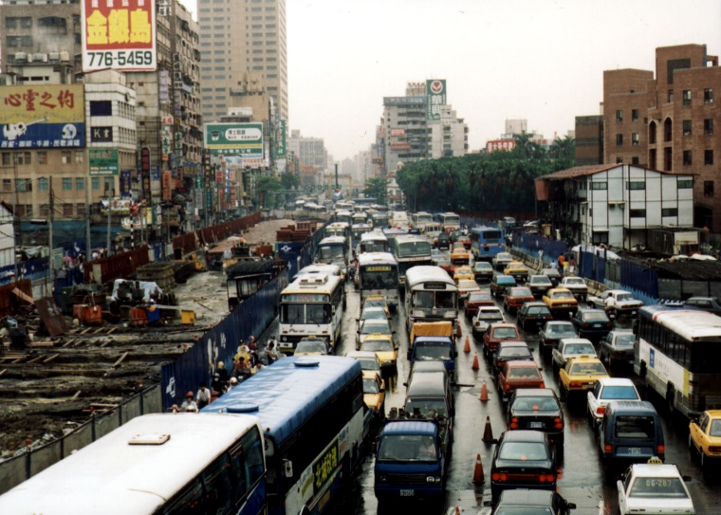
Methodology for Classification
Support Vector Machine(SVM):
Kernel Types Tested: Linear, Polynomial, RBF
Best Kernel: RBF (Radial Basis Function)
Hyperparameter Tuning: Performed using GridSearchCV(C, Gamma)
Training Method: 5-fold cross-validation
Multilayer Perceptron (MLP) Classifier:
Hyperparameter Tuning: Performed using GridSearchCV.
Tuned Parameters:hidden_layer_sizes: [(50,), (100,), (50, 50)],activation: ["relu", "tanh"],solver: ["adam"],alpha: [0.0001, 0.001],learning_rate: ["constant", "adaptive"].
Training Method: 3-fold cross-validation.
Best Parameters Found:hidden_layer_sizes = (100,),activation = "relu", solver = "adam", alpha = 0.0001, learning_rate = "constant“.
Random Forest Classifier
Hyperparameter Tuning: Performed using GridSearchCV.
Tuned parameters: n_estimators (number of trees), max_depth, min_samples_split, min_samples_leaf, bootstrap.
Training Method: 5-fold cross-validation.
Best Parameters Found: n_estimators =100 ,max_depth = None , min_samples_split = 2, min_samples_leaf = 1, bootstrap = None.

Slide 6
Classification Result
Time Series Result
LSTM:
Metrics: Test Loss (MSE): 0.0019, R² Score :0.9398.
Strengths: Performed well in capturing general patterns and trends. Training was stable with no overfitting.
Limitations: The model uses a standard, which only looks at past data.
Bi-LSTM:
Metrics: Test Loss (MSE): 0.0019 , R² Score: 0.9396.
Insights: Demonstrated the highest accuracy and best generalization. Especially effective in capturing bidirectional temporal dependencies.
Strengths: Smooth training, low validation and testing error, and superior performance on unseen data.
ESN:
Metrics: Test Loss (MSE): 0.0030, R² Score: 0.9053 .
Challenges: While fast and efficient, it struggled to capture sudden or nonlinear fluctuations in the time series.
Strengths: Lightweight model with quick training, suitable for simpler temporal tasks.
Random Forest:
Accuracy: 99.66%, AUC-ROC: 99.97%.
Strengths: Outstanding performance with near-perfect classification. Offers robustness and handles imbalanced data well
SVM:
Accuracy: 93.64%, AUC-ROC: 96.67%.
Strengths: Good interpretability and reliable results, but lower performance compared to other models in both accuracy and AUC-ROC
MLP:
Accuracy: 98.68%, AUC-ROC: 99.92%.
Strengths: Shows a strong balance between precision and recall, making it suitable for capturing nuanced patterns in the data

Slide 7
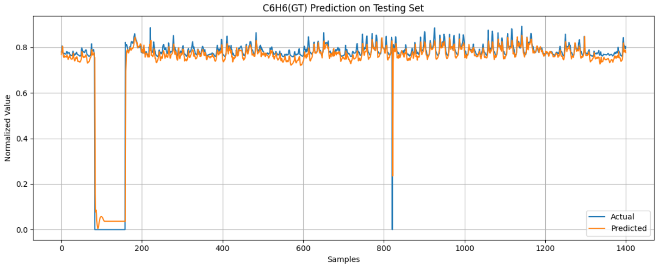
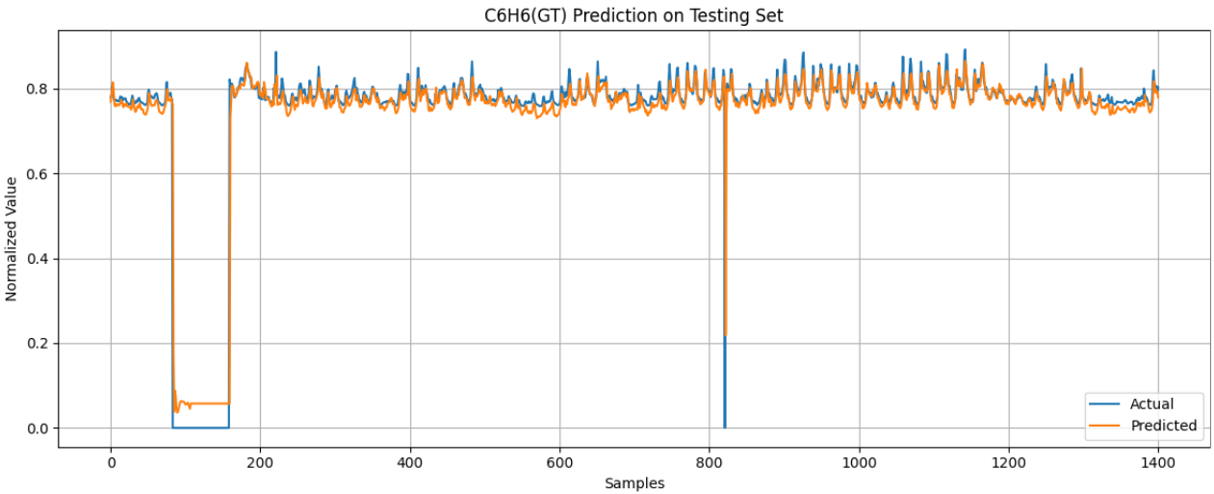
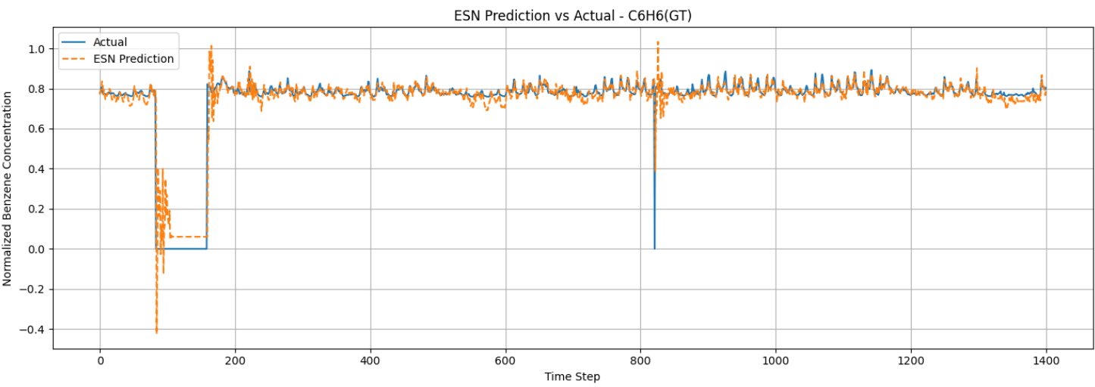
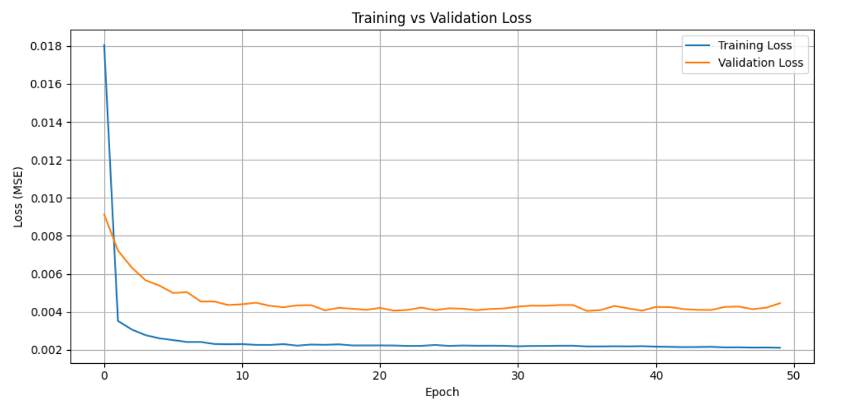
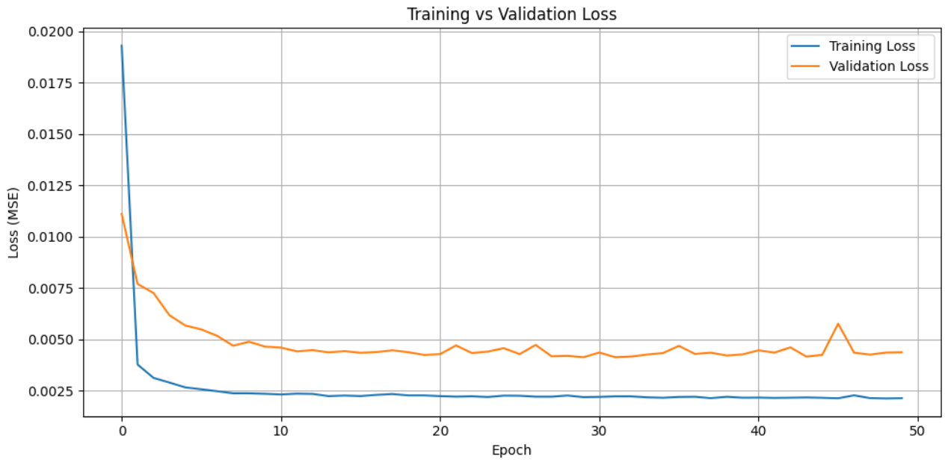
Graphical Results – Time series models
LSTM
Bi-LSTM
ESN

Slide 8
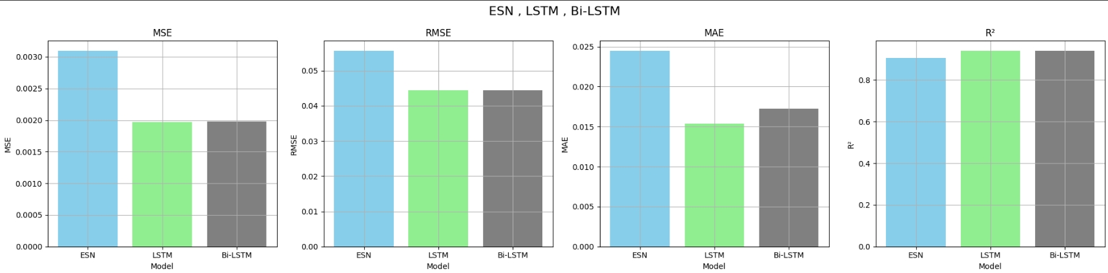
performance comparison
Time Series For Three Models
A performance comparison between ESN, LSTM, and Bi-LSTM was conducted using MSE, RMSE, MAE, and R². LSTM achieved the best results, with the lowest error metrics (MSE = 0.001967, MAE = 0.015350) and the highest R² score (0.94), indicating excellent predictive accuracy. Bi-LSTM performed comparably, with slightly higher errors and a nearly identical R² score (0.94), showing it is also a strong model. In contrast, ESN had the highest error values and the lowest R² (0.91), making it the least accurate among the three. Overall, LSTM was the most effective model for time series prediction of C6H6(GT) concentrations.

Slide 9
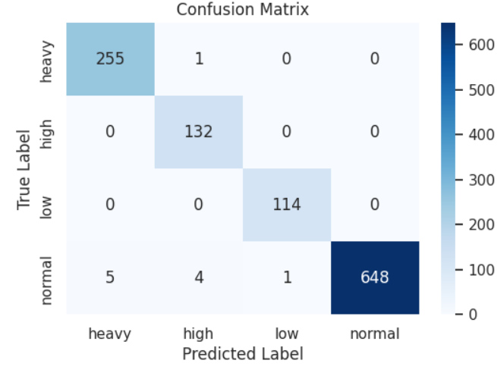
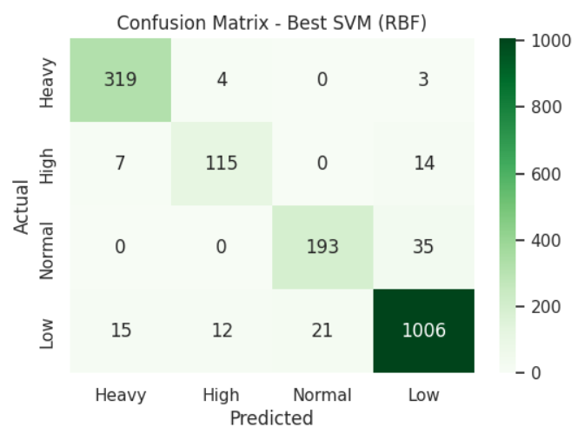
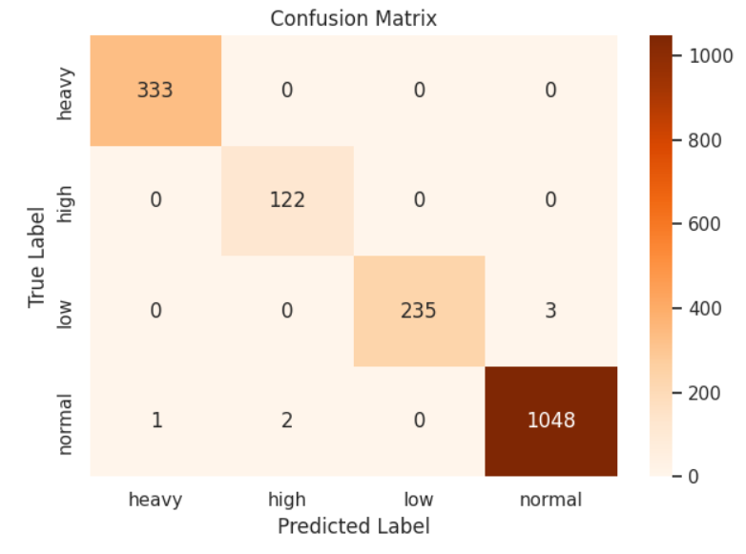
Graphical Results – Classification Models
Confusion Matrices:
MLP
SVM
Random Forest

Slide 10
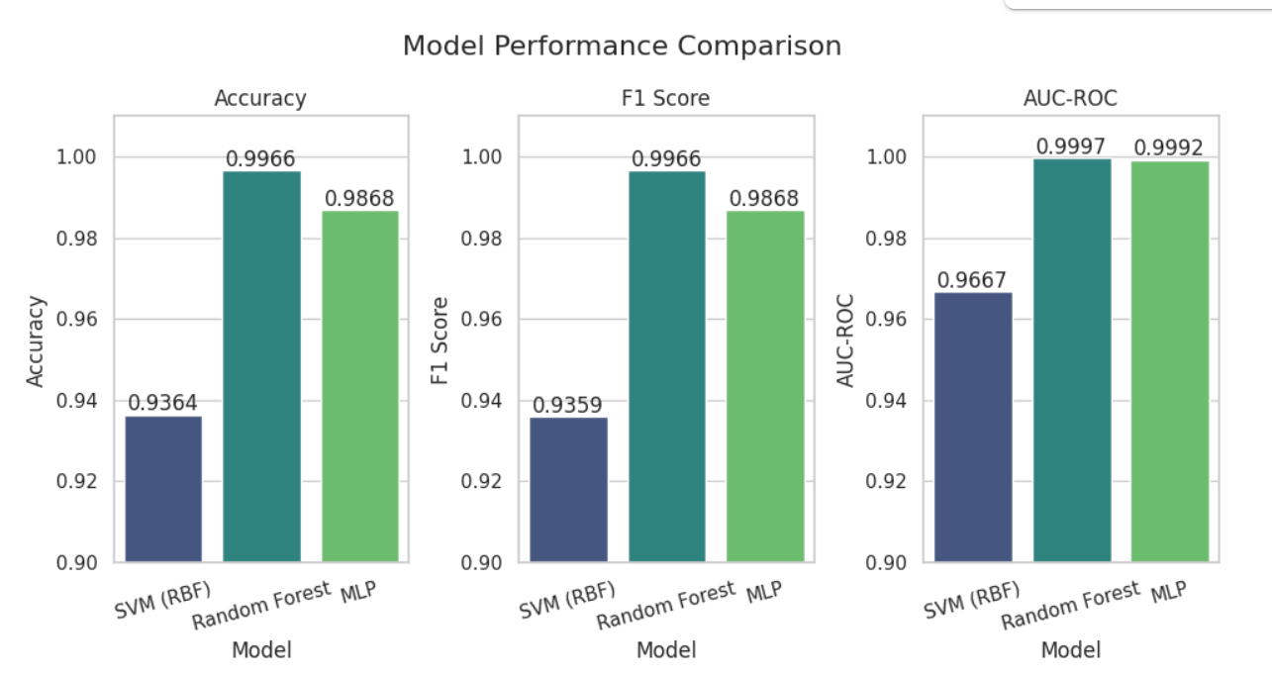
performance comparison
The chart compares the performance of three machine learning models SVM (RBF), Random Forest, and MLP on a classification task using three evaluation metrics: Accuracy, F1 Score, and AUC-ROC. Among the models, Random Forest consistently outperformed the others, achieving the highest scores across all metrics, with an accuracy and F1 score of 0.9966 and an AUC-ROC of 0.9997, indicating excellent classification and generalization ability. The MLP model also performed very well, with an accuracy and F1 score of 0.9868 and an AUC-ROC of 0.9992, slightly below Random Forest. In contrast, the SVM (RBF) model showed comparatively lower performance, with an accuracy of 0.9364, F1 score of 0.9359, and AUC-ROC of 0.9667. Overall, Random Forest demonstrated the most robust and reliable results for the task.
Classification For Three Models

Slide 11
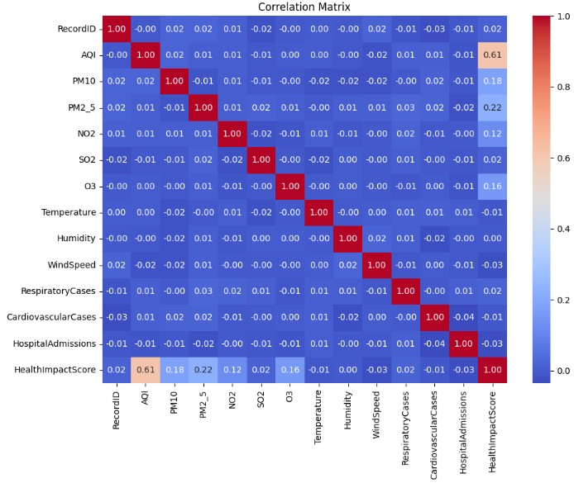
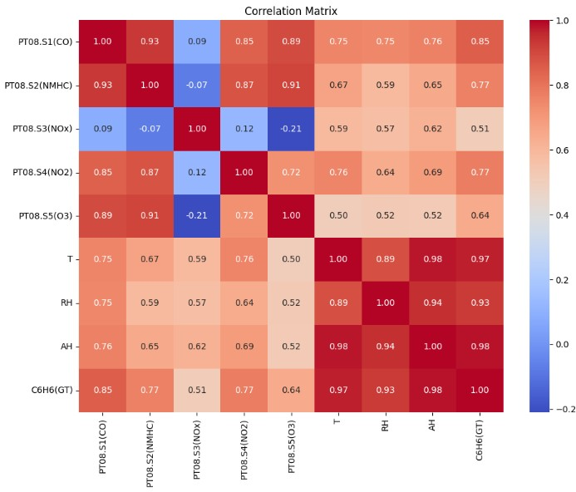
Challenges and Solutions Encountered
🔴 Challenge: We initially worked with a dataset related to air quality, where we tried to predict the HealthImpactScore.However, we faced a major issue:
The Mean Squared Error (MSE) was very high, and the R² Score was negative, which indicated that the model wasn’t learning properly.
After generating a correlation heatmap, we found that there was no strong correlation between the features. This made it hard for the model to make accurate predictions.
✅ Solution: We decided to change the dataset entirely. We selected a new dataset focused on predicting benzene concentration in the air , and Before training the models:
We checked the correlation between features, and this time the relationships were much stronger.
As a result, the model performance significantly improved.
Old dataset
New dataset

Slide 12
Thank You

